Slide 1
Refund / Amount Owed
Pub 4012 Tab K
(Federal 1040-Lines 75-79)
Notes:
1

Slide 2
TS – NJ Refund Options E-File Section \ State Return Type
State Return Type has same 4 options as Federal,
but in a different order
Notes:
The State Return Type has the same 4 options as the Federal, but in a different order
2

Slide 3
Refunds Applied to Next Year’s Taxes
Can choose to apply all or part of current year’s refund to next year’s taxes
Enter in Federal Section \ Payments and Estimates \ Apply Overpayment to Next Year's Taxes
TaxSlayer will populate amount to be applied to next year on 1040 Line 77 and re-calculate amount of refund taxpayer will receive this year
Can also choose to apply NJ refund to next year’s taxes
Enter in State section \ Edit \ Enter Myself \ Payments
Notes:
3

Slide 4
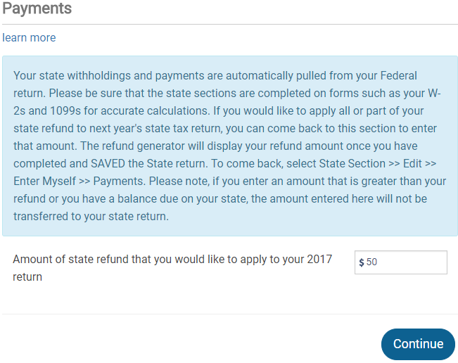
TS – NJ Refund Applied to Next Year’s Taxes State section \ Edit \ Enter Myself \ Payments
Amount of NJ refund applied to next year’s taxes
Notes:
4

Slide 5
Tax Penalty for Underpayment of Taxes
TaxSlayer will issue a warning during e-file process if taxpayer may owe penalty (i.e. - owes an amount greater than $1,000 (Federal) /$400 (NJ)
Penalty is Out of Scope, so choose option to file without including penalty (Form 2210)
Alert taxpayer that they may receive a letter from IRS or NJ
Make a note that alert was given to taxpayer in Intake/Interview sheet notes section and in TaxSlayer notes
Notes:
Counselors should discuss the possibility of an IRS penalty with taxpayer
If there is a penalty, the IRS will notify taxpayer with a letter
5

Slide 6
Conditions When Estimated Tax Payments are Required for Next Year
Taxpayer tax liability in current year more than what was withheld and/or paid in advance AND
Taxpayer expects to owe for next year more than $1,000 (Federal)/$400 (NJ) after subtracting tax withheld & tax credits from tax liability AND
Taxpayer expects next year’s tax withheld to be less than:
90% of the tax liability on next year’s return, or
100% of tax liability shown on current year’s return
Estimated taxes required if taxpayer is self-employed
Notes:
6

Slide 7
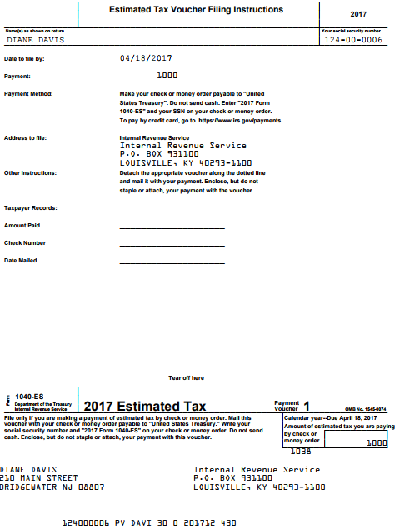
TS – Federal Estimated Taxes Voucher for Next Year – Form 1040-ES
For taxpayer records
Cut off voucher and
submit with payment
Mail in separate envelope from any balance due on current tax year return
Notes:
7

Slide 8
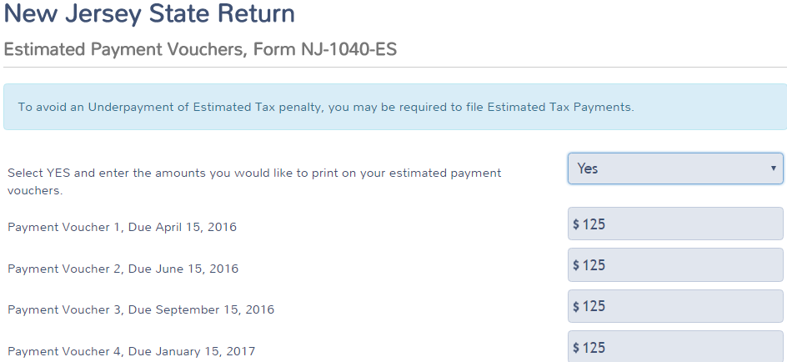
TS – NJ Estimated Taxes for Next Year - Form NJ-1040-ES State Section \ Edit \ Enter Myself \ Miscellaneous Forms \ Estimated Payment Vouchers, Form NJ-1040-ES
Choose Yes from drop-down menu
Payment due 4/15
Payment due 6/15
Payment due 9/15
Payment due 1/15
Notes:
8

Slide 9
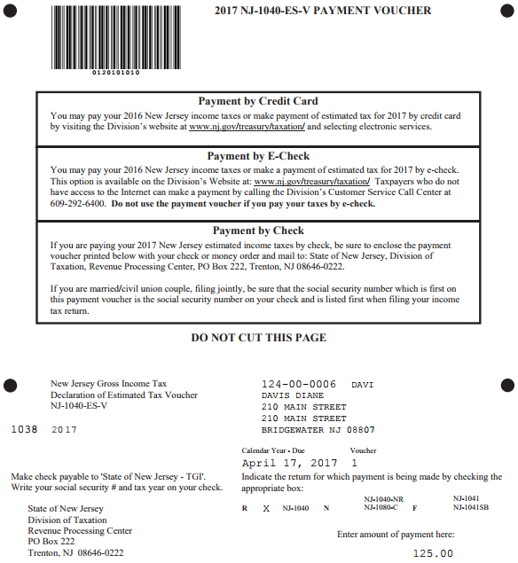
TS – Estimated Payment Vouchers, Form NJ 1040-ES
Mail in the entire page with estimated tax payment;
Mail separately from any balance due on current year tax return
Voucher for first estimated payment

